Slide 1
Diversity and Inclusion – 2021/2022 EPCA survey outcome
Members’ version
April 2022
CONFIDENTIAL AND PROPRIETARY
Any use of this material without specific permission of EPCA is prohibited

Slide 2
User manual
Feel free to customize any active parts (element/textbox) in the slide (source infographics are locked).
Please share the results (these slides) with your communication/marketing experts for adaptation and integration of your company results in the best possible way
Remember to delete any active element which is not relevant (instructions, empty textboxes, arrows, etc.)
After modification, save a single slide as .jpg or .png and for multiple used for example in LinkedIn carousel save as .pdf – how to click here.
Don’t forget to tag @EPCA-eu when posting!
For any support, please contact Silke at communications@epca.eu

Slide 3
User manual
1. Identify customisable text blocks in the slide
EXAMPLE

Slide 4
User manual
2. Fill the boxes with your data and messages
EXAMPLE

Slide 5
User manual
3. Convert the slide into the right image format to be posted on your company’s social media, e.g.:
EXAMPLE

Slide 6
SET OF SLIDES

Slide 7
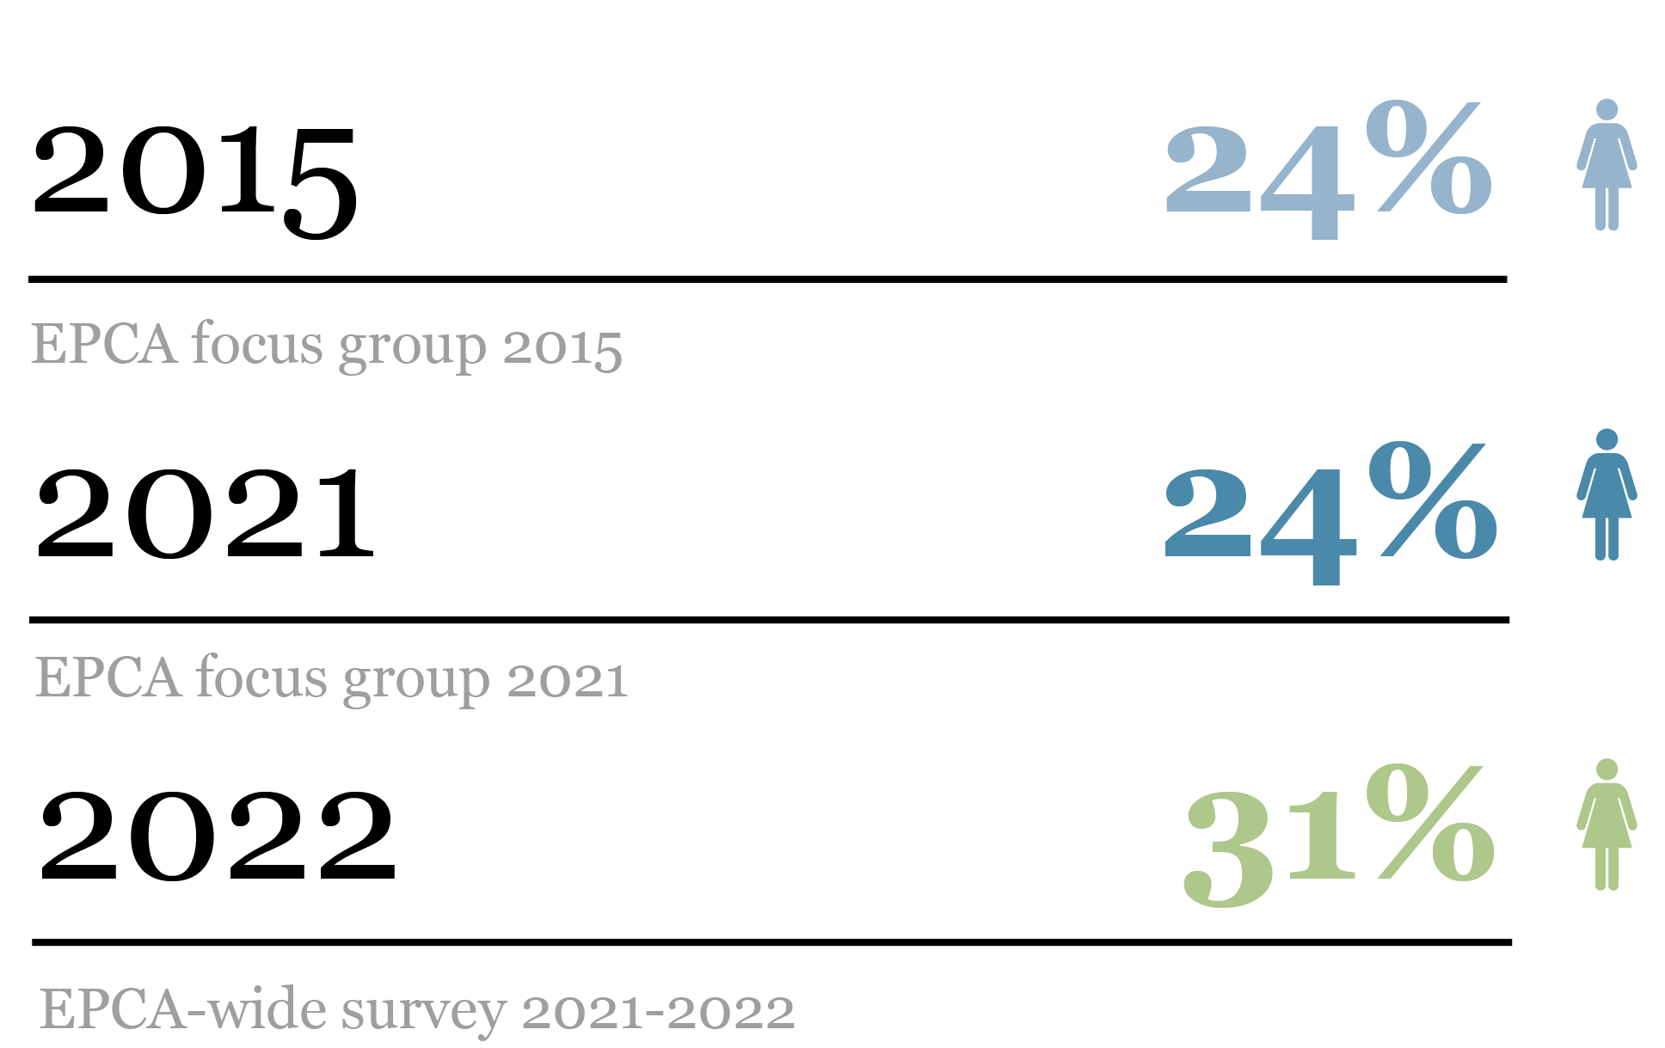
Edit your
message here
Overall percentage of women in companies overall did not increase in focus group since 2015. The share in the EPCA-wide survey is higher
Average percentage of women in companies overall
Add your data here
XX%
Edit your data here
Company name XX%

Slide 8
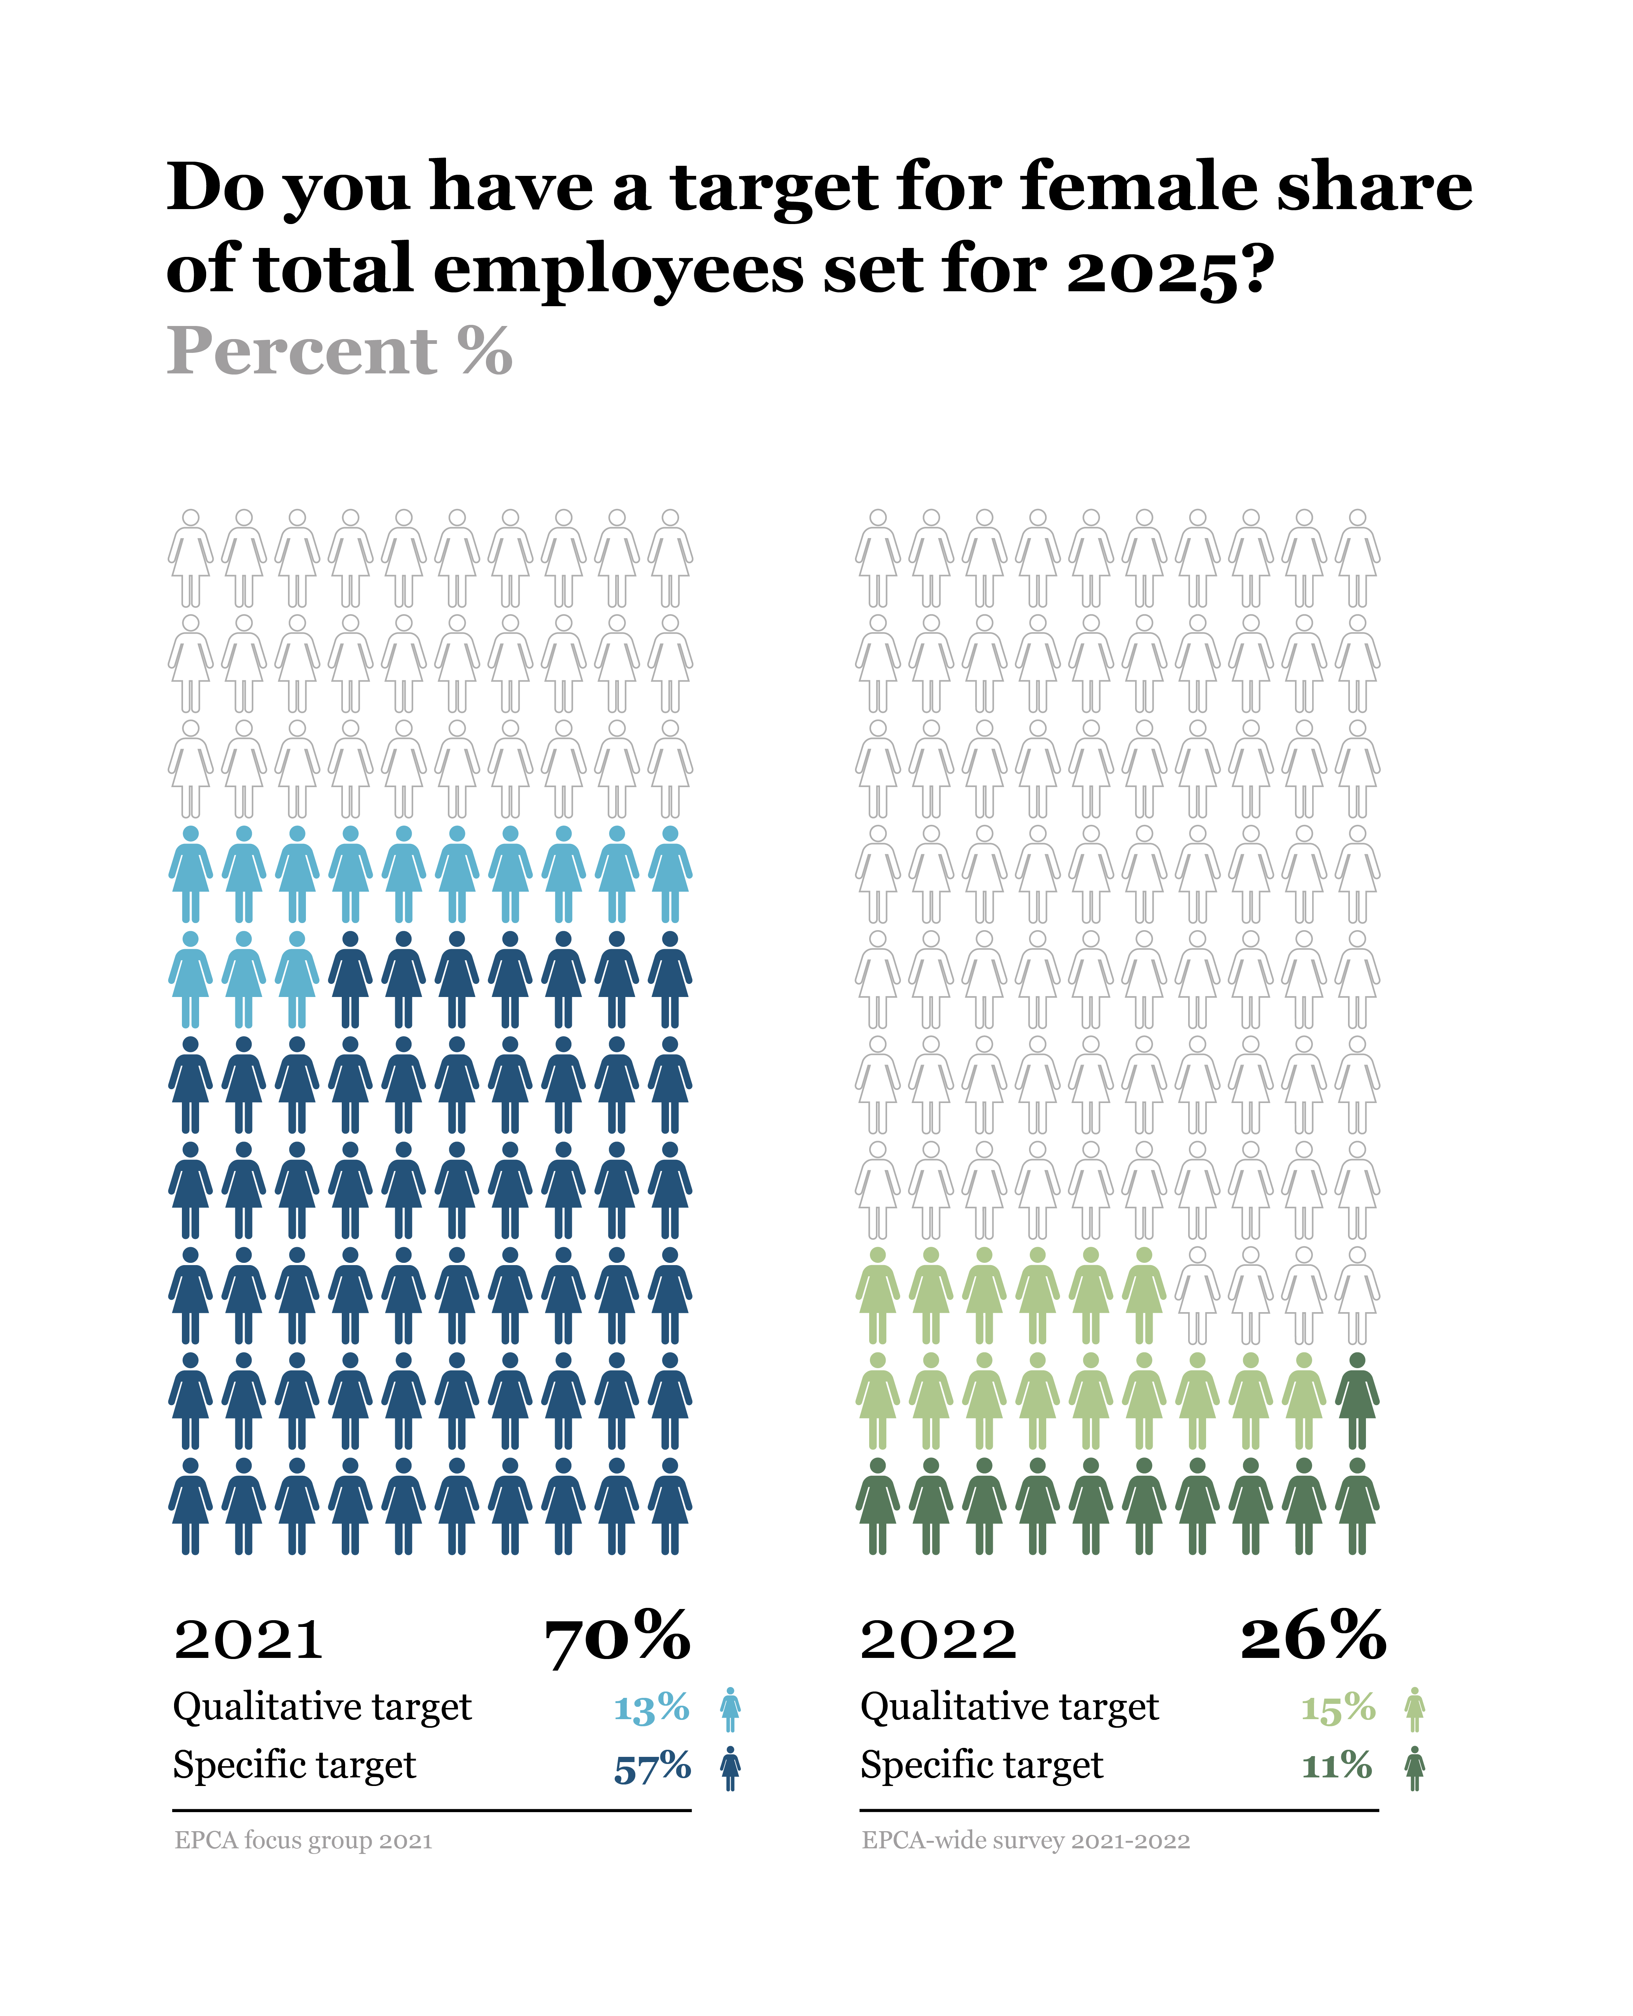
Focus group members have largely set targets – 3/4 of companies surveyed EPCA-wide do not have yet
Add your
message here
Company name
Qualitative targets
XXX
XXX
XXX
Specific targets
XXX
XXX
XXX
Add your data here

Slide 9
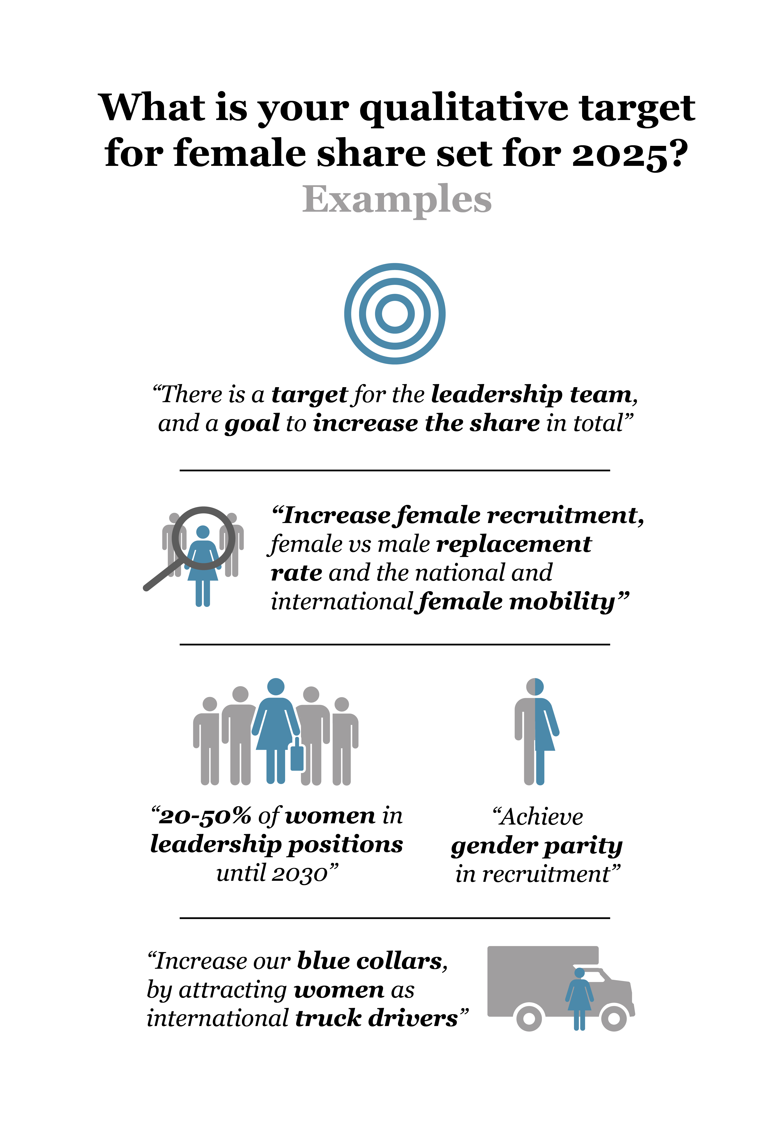
Focus group members have largely set targets – 3/4 of companies surveyed EPCA-wide do not have yet
Add your
message here

Slide 10
Not all chemical companies track key diversity dimensions yet, particularly in the wider EPCA community
Add your
message here
Company name XXXX
XX% of XXX staff
attends such events
XXX has XX%
Gender dedicated
recruiting events
Not tracked
Not tracked
Choose your option
In progress
XX
YES
XX
NO
XX

Slide 11
Gender specific recruiting activities in place – with room for further diversification
Add your
message here
Company name XXXX
XX% of XXX staff
attends such events
in 2022 - 2023
NO
XX
insert your option
YES
Nothing
planned
XX
In progress
XX

Slide 12
Inclusive culture and behaviors still largely lacking – companies can shape their environment, so it enables diverse talent to succeed
Add your
message here
Company name XXXX
Choose your option
In progress
XX
NO
XX
YES
XX

Slide 13
Senior management ownership and cascading gender quality down the organization still an opportunity
Add your
message here
Not on the strategic agenda | On the strategic agenda but not in the top 5 | On the strategic agenda
16%
27%
19%
24%
20%
49%
55%
62%
64%
32%
21%
11%
Choose your option here
(Delete options that are not applicable)
Company name
Not on the strategic agenda
On the strategic agenda but not in the top 5
On the strategic agenda
Not on the strategic agenda
On the strategic agenda but not in the top 5
On the strategic agenda
Not on the strategic agenda
On the strategic agenda but not in the top 5
On the strategic agenda
Not on the strategic agenda
On the strategic agenda but not in the top 5
On the strategic agenda

Slide 14
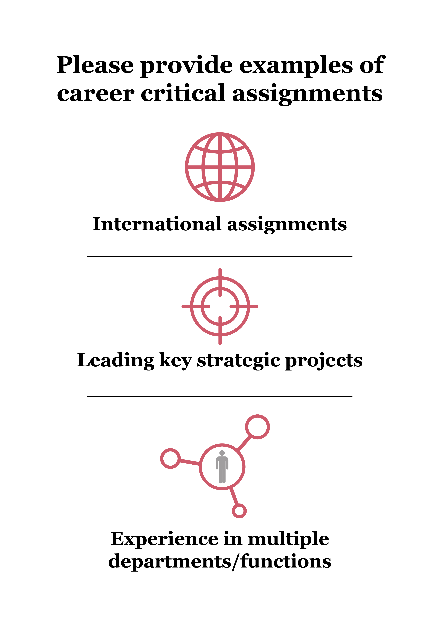
Providing career advancing opportunities to diverse talents and moving from mentorship to sponsorship
Add your
message here

Slide 15
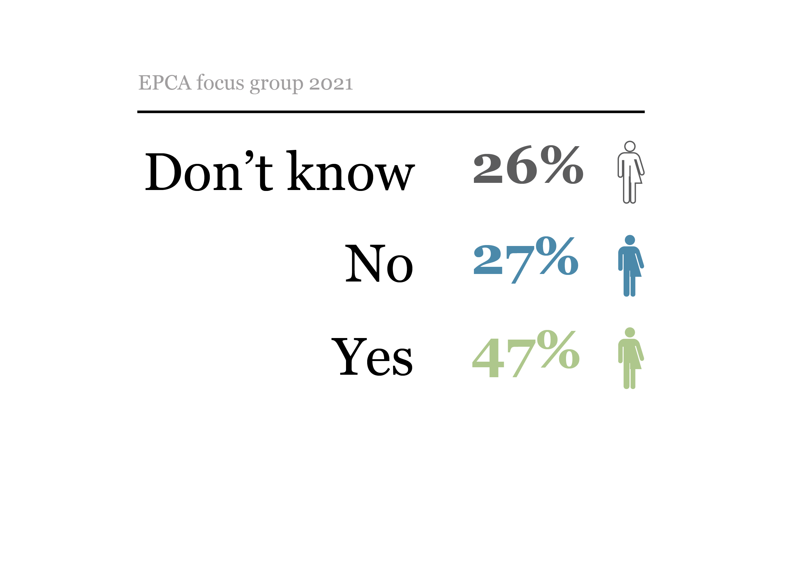
Providing career advancing opportunities to diverse talents and moving from mentorship to sponsorship
Add your
message here
Does your organization have in place processes to ensure women and men have equal access to career-critical assignments? Percent %
Add your data here
Company name
Career-critical assignments
XXX
XXX
XXX

Slide 16
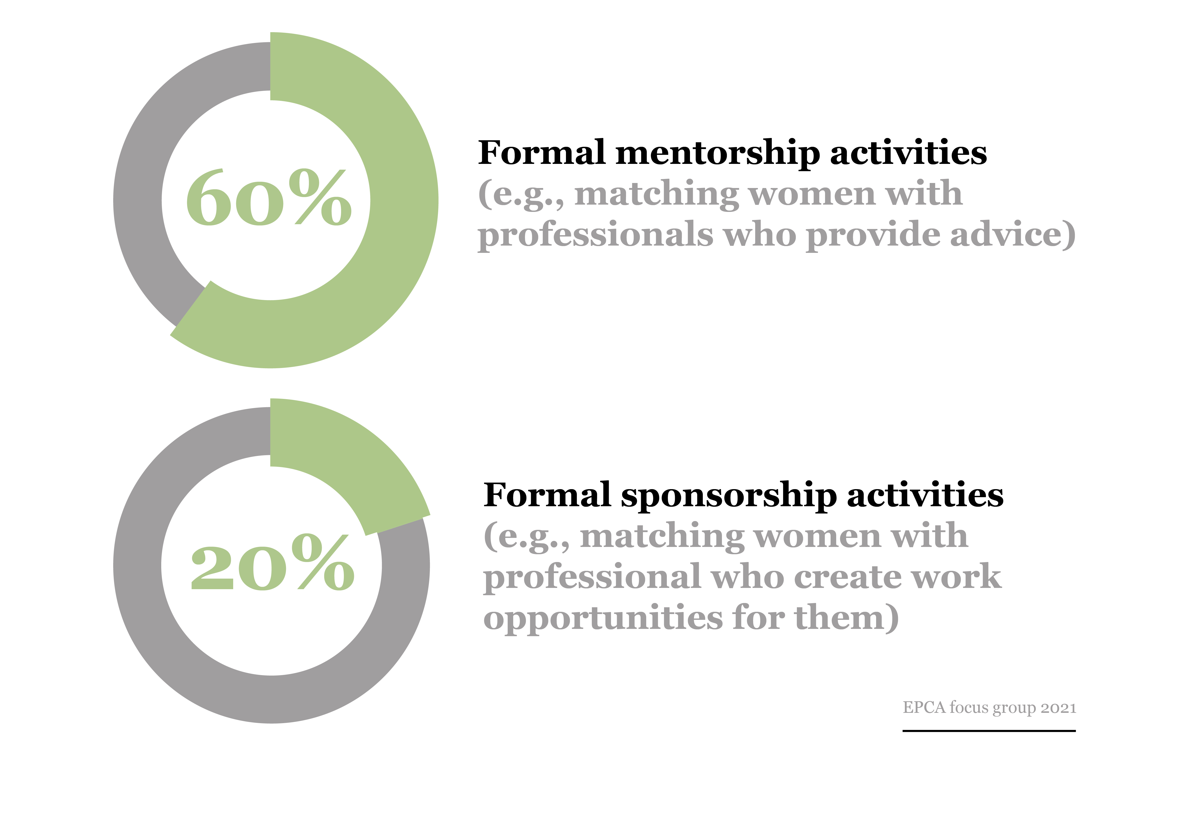
Providing career advancing opportunities to diverse talents and moving from mentorship to sponsorship
Add your
message here
What types of gender specific talent development activities does your organization offer for women? Percent of companies with activities being current practice
Add your data here
Company name
Development activities
XXX
XXX
XXX

Slide 17
Flexible work is offered by most companies – improvement in less traditional options is possible
Add your
message here
Company name XXXX
XX
XX
XX
XX
Choose your option
In progress
XX
NO
XX
YES
XX

Slide 18
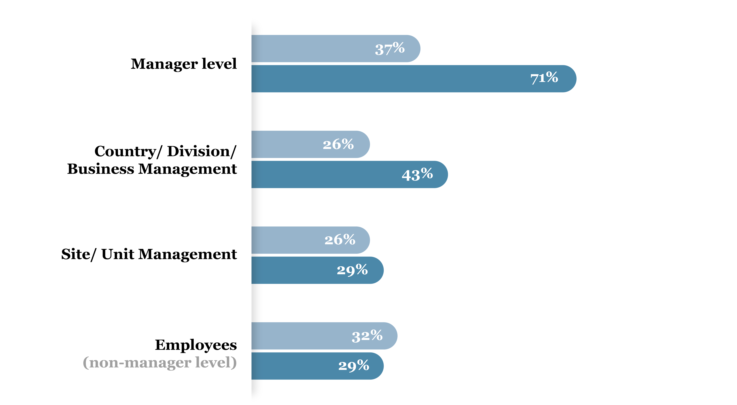
Great progress to track and measure gender – yet room for further improvement
Add your
message here
Company name XXXX
Choose your option
YES
NO
In progress
In progress

Slide 19
Great progress to track and measure gender – yet room for further improvement
Add your
message here
Company name XXXX
YES
Choose your option
NO
In progress
In progress
In progress

Slide 20
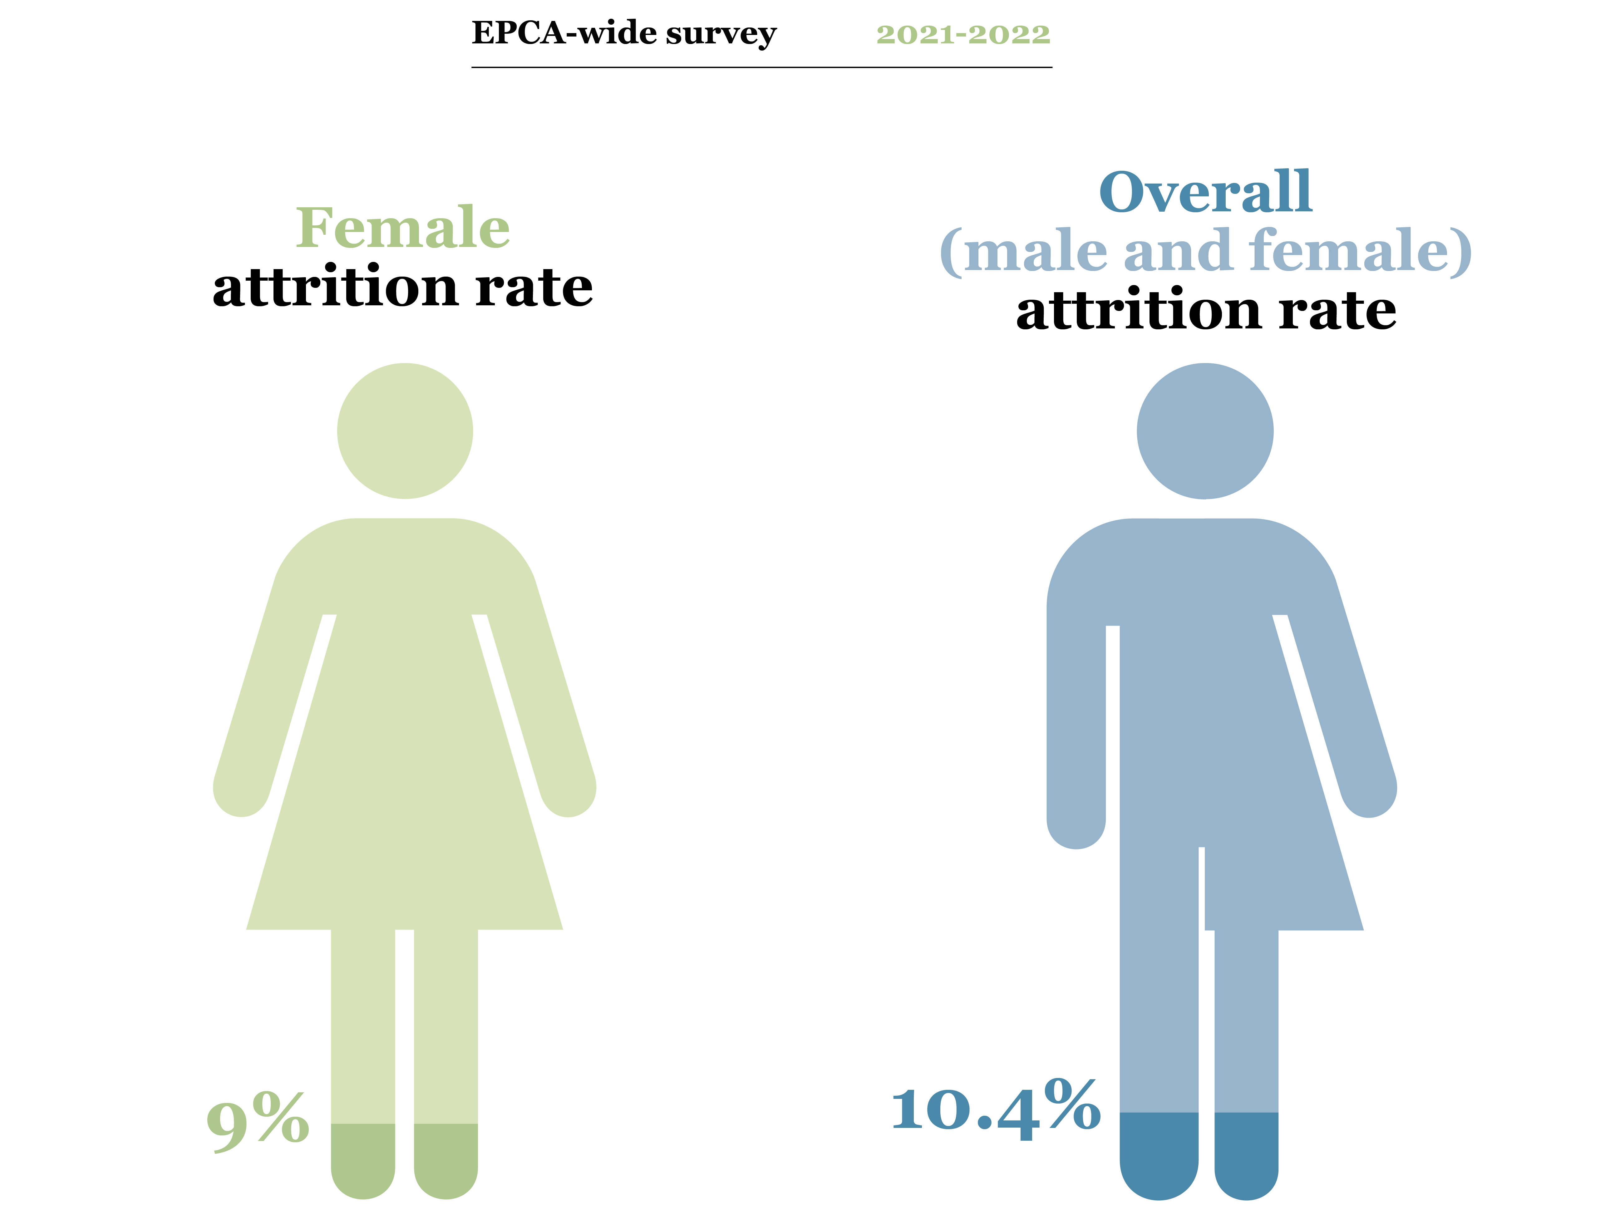
In 2021, female attrition rate was similar to overall attrition rate in chemical companies surveyed
Add your
message here
Company name XXXX
Add your data here
Add your data here
XX%
XX%

